Slide 1
Presentation by
Muhammad Raees (mr2714@rit.edu)
Kaleem Nawaz Khan (kk5271@rit.edu
Project 1
Linear Feature Engineering

Slide 2
Contents
Linear Regression Model
Feature Selection
Cross-Validation
Overfitting
Conclusion

Slide 3


Linear Regression Model
Linear Model
y = W^{T}Z
w = (Z^{T}Z)⁻¹ (Z*y)
Mean Squared Error
Dataset
Input: 928*8 (Z)
Output: 926*1 (y)
The training error with linear model with original 8 features
= 109.39

Slide 4
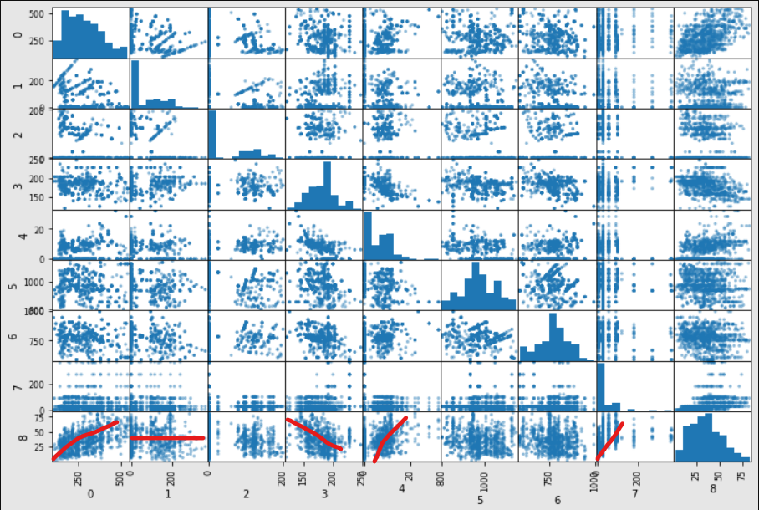
Feature Selection
Started training with original features
Then applied feature selection (Training Error=125.5)

Slide 5
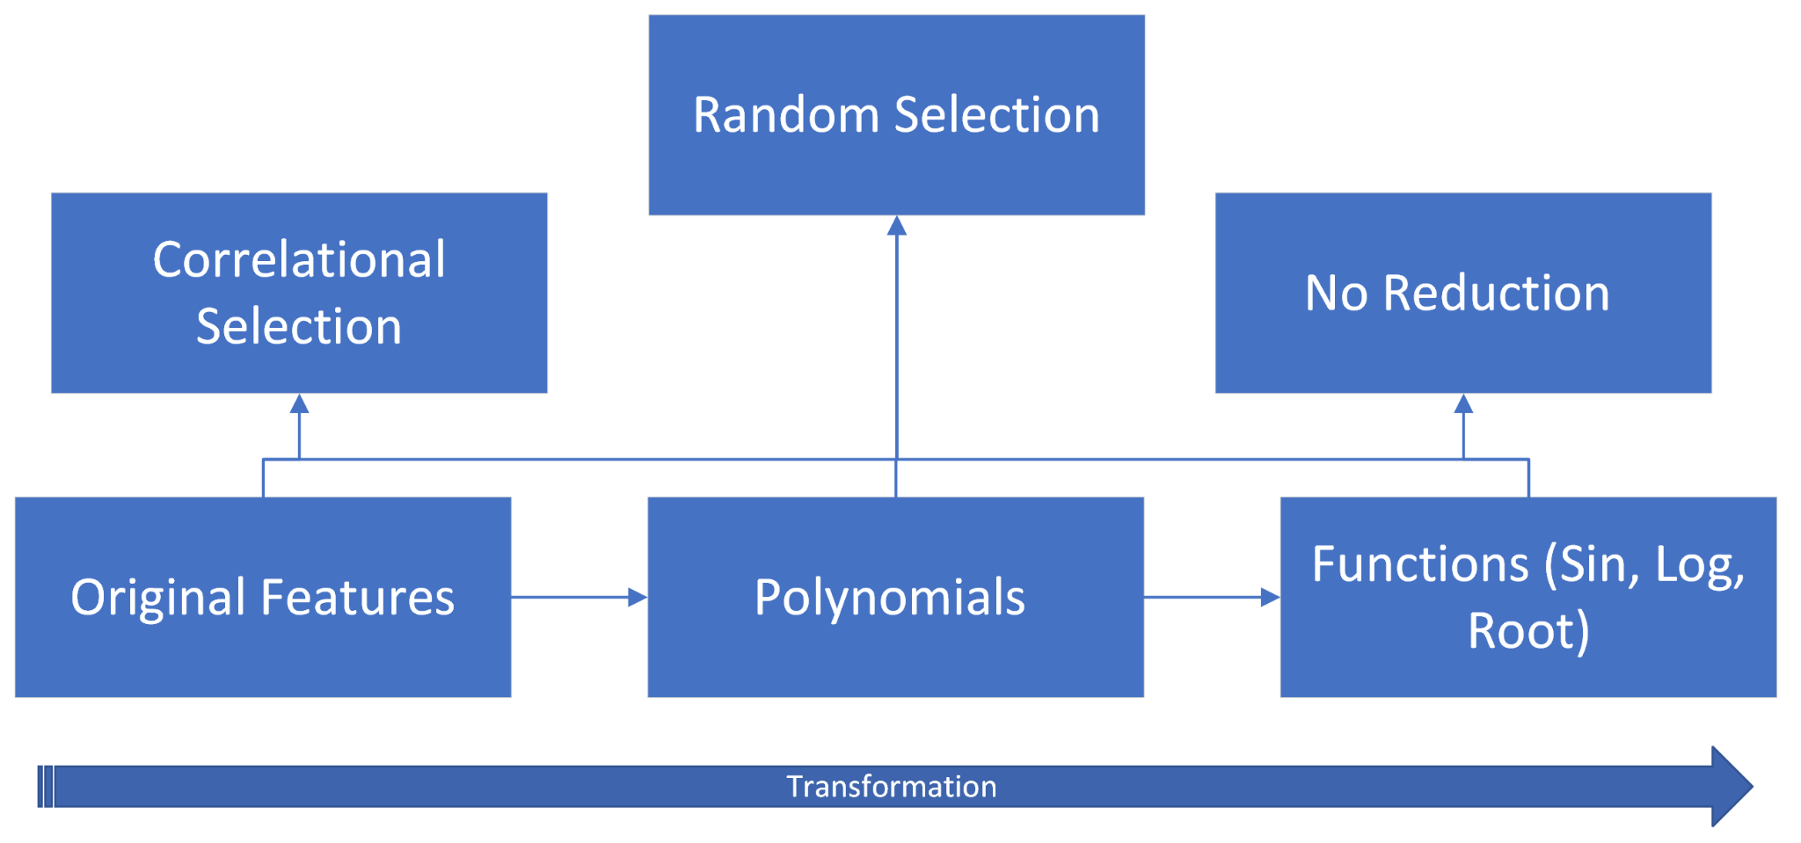
Feature Selection

Slide 6
Feature Selection
Following combinations of features are applied and tested
X | X + X² | X + X² + X³
X + Sin(X) | X + Sin(X) + Log(X) | X+X² + X³ + Sin(X)+Log(X)
X+ X² + Sin(X) | X + X² + X³ + Sin(X) | X + X² + X³ + Sin(X) + X^{1/2}
X + X² + Log(X²) | X + X² + X³ + X^{1/2} | X+ X² + X³ + X⁴

Slide 7
Feature Selection
Feature Set | Feature Count | Train Error | Test Error
Original Features | 8 | 107.2 | 132.5
Higher-order features (X, X², X³) | 24 | 42.7 | 67.8
Higher-order features (upto X⁴) | 32 | 34.5 | 130.5
Higher-order features (upto X⁵) | 40 | 31.8 | 519.5
Higher-order features (sin, log, X³) | 40 | 30.7 | 79.6

Slide 8
Feature Selection
Performed on all feature sets (previous slide)
Error is reported on average of features
Feature Set | Feature Count | Train Error (Avg of feature sets | Test Error Avg of feature sets
Reduced Features (Correlation) | ⅝ of total | 62.4 | 172.45
Reduced Features (Random) | upto ⅝ of total | 63.6 | 173.8

Slide 9
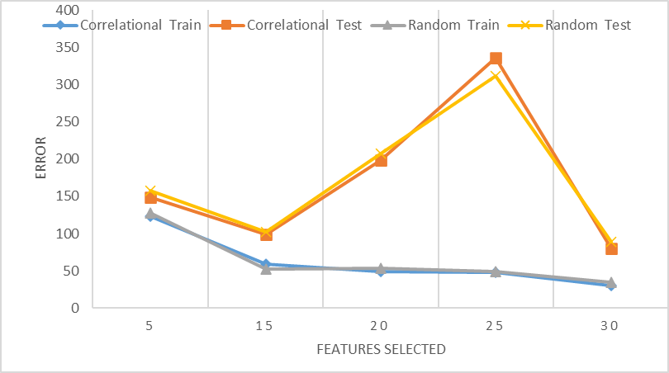
Feature Selection
Error is reported on reduced features

Slide 10
Cross Validation
K-Fold Cross Validation
Divide training set into training and validation set
Varying K
3, 5, 8, 10
K=5 is used in the final code
Recorded cross validation on
Original Features
Higher-order Features
Reduced Features

Slide 11
Overfitting
Test error is estimated while applying cross-validation on the training set/validation set.
Validation error increases with
Higher-order polynomial > X³ , i.e., increasing complexity
Reducing polynomial degree, i.e. X^{1/2}
Functions such as, Sin, Log, etc.
Increasing complexity reduces training error at the cost of validation error (overfitting)
Stuck with X³
Used K-fold cross-validation to report and keep a check on overfitting

Slide 12
Conclusion
The linear regression model is trained on data.
Training model on original features does not captures the underlying pattern.
Higher order models can approximate better and reduce overfitting.
Increasing degree of model to > X³ increases overfitting.
Cross-validation provides better estimates of validation error.

Slide 13
Thank you!
Questions?

